Slide 1
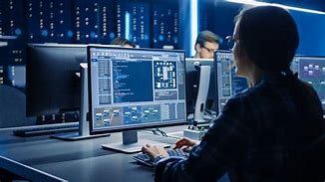
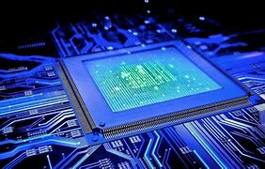
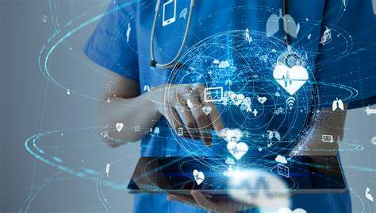
THE COMPUTER
NAME :- Ulindu Eshan Samaradheera
INDEX NO. :- 5427
DEPARTMENT :- Physical Science

Slide 2
¡ Content ¡
Introduction to computers
Computer generations
Types of computers
Uses of computers in various fields
Reference

Slide 3

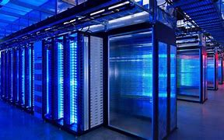
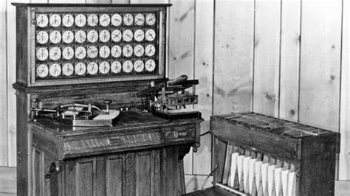
Introduction to computers
Computers have become an integral part of our modern society, with their widespread use in almost every aspect of our lives.
In simple terms, a computer is a device that processes information using electronic circuits.
At its core, a computer consists of two main components: hardware and software.
Hardware refers to the physical components of a computer, including the central processing unit (CPU), memory, storage devices, input/output devices (such as keyboards and monitors), and other peripherals.
Software, on the other hand, refers to the programs and data that are stored and executed on the hardware. There are two key types of software: the system software (e.g., operating systems) that manages the computer's resources, and application software (e.g., word processors, web browsers) that enables users to perform specific tasks.

Slide 4
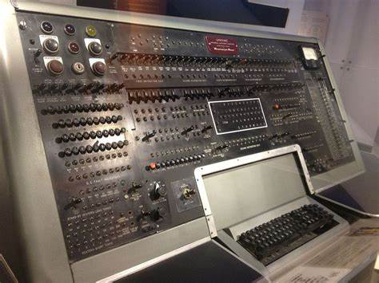
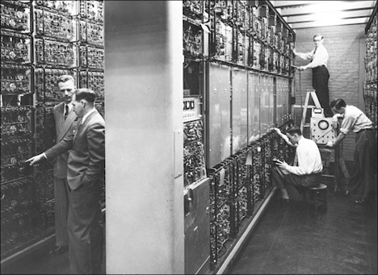
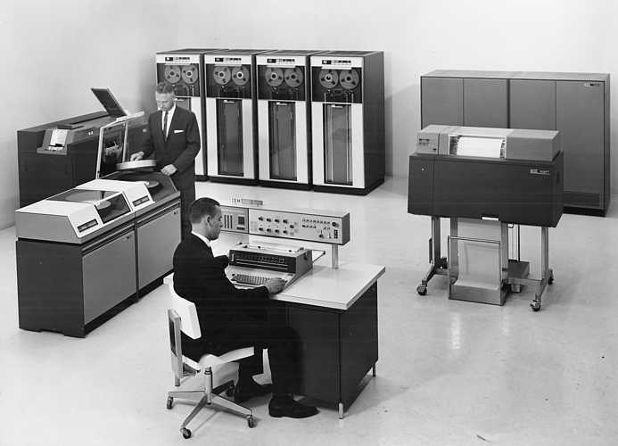
Computer generations
First Generation (1940s-1950s):
The first generation of computers were large and used vacuum tubes for circuitry.
They were very expensive, consumed a lot of electricity, and generated a significant amount of heat.
Examples include ENIAC and UNIVAC.
Second Generation (1950s-1960s):
The second generation saw the introduction of transistors, replacing vacuum tubes.
Transistors were smaller and more reliable, resulting in smaller and less power-hungry computers.
These computers used punch cards or magnetic tape for input/output.
Examples include IBM 1401 and DEC PDP series.
Graphical user interfaces (GUI), networking, and the internet became mainstream.
Laptops, smartphones, and tablets emerged as portable computing devices.
Examples include IBM ThinkPad, Apple MacBook, and smartphones like iPhone and Android devices.

Slide 5
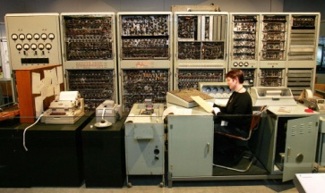
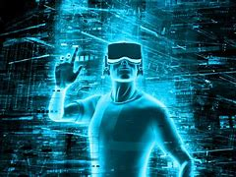
Third Generation (1960s-1970s):
The third generation brought the integration of transistors onto a single silicon chip called an integrated circuit.
This advancement allowed computers to become even smaller, more powerful, and more affordable.
High-level programming languages such as COBOL and FORTRAN were introduced during this era.
Examples include IBM 360 and DEC-10.
Fourth Generation (1970s-1980s):
The fourth generation was characterized by the development of microprocessors, which included the entire computer's central processing unit on a single chip.
This made computers even smaller, faster, and more energy-efficient.
Personal computers (PCs) became more accessible to individuals and businesses.
Examples include IBM PC, Apple II, and Commodore PET.
Fifth Generation (1980s-Present):
The fifth generation represents the era of modern computers, which are characterized by their use of microprocessors, large-scale integration, and advanced software.

Slide 6
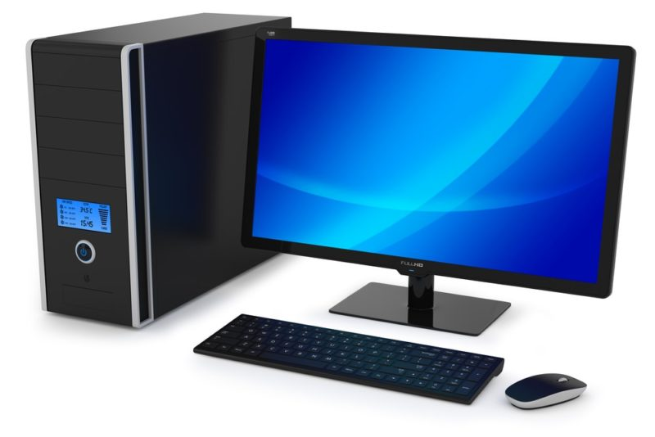
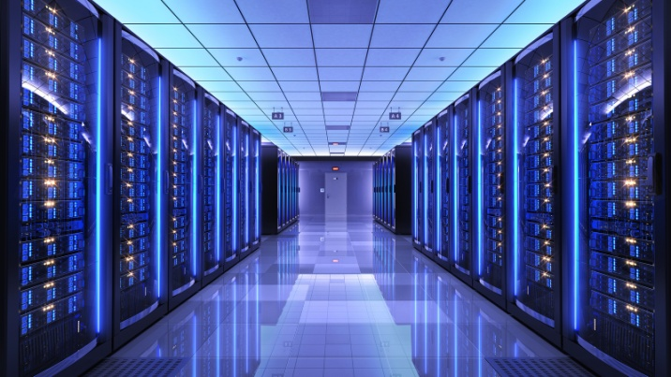
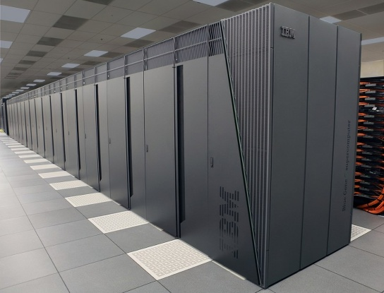
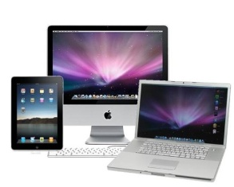
Types of computers
Personal Computers (PCs):
PCs are the most widely used type of computer and are designed for individual use.
They are available as desktop computers or laptops and are suitable for general computing tasks, such as web browsing, word processing, multimedia consumption, and gaming.
Servers:
Servers are computers designed to provide services to other computers or devices on a network.
They are typically more robust and powerful than personal computers to handle multiple client requests simultaneously.
Servers are used for tasks like hosting websites, managing databases, file sharing, email services, and cloud computing.

Slide 7
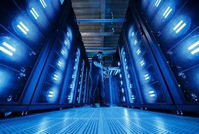
Mainframes:
Mainframes are large-scale, high-performance computers used for critical applications in large organizations and government institutions.
They are known for their ability to handle massive data processing, support multiple users simultaneously, and provide high reliability and security.
Mainframes are used in sectors such as finance, healthcare, and telecommunications.
Supercomputers:
Supercomputers are the most powerful computers, capable of processing vast amounts of data at incredibly high speeds.
They are used for complex scientific simulations, weather forecasting, cryptography, and specialized high-performance computing tasks.
Supercomputers often consist of numerous processors interconnected to solve intricate calculations quickly.
Embedded Computers:
Embedded computers are small-scale, specialized computers embedded in various devices and systems.
They are designed for specific functions and are found in things like smartphones, digital appliances, automobiles, medical devices, and industrial control systems.
Embedded computers are optimized for efficiency and often have limited user interfaces or operate autonomously.

Slide 8
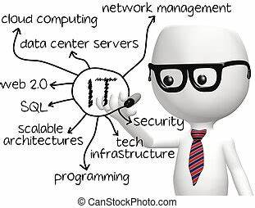
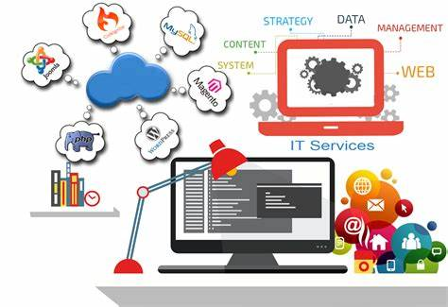
Uses of computers in various fields
Education:
Computers are used in classrooms for interactive learning, multimedia presentations, and access to educational resources.
They aid in distance learning programs, online courses, and virtual classrooms.
Educational software assists in assessments, student tracking, and personalized learning.
Healthcare:
Computers are used for electronic medical records (EMR), storing and accessing patient data securely.
Medical imaging technologies such as X-rays, MRIs, and CT scans rely on computer processing.
Computers assist in diagnosing diseases, monitoring patient vitals, and simulating surgical procedures.
Business and Finance:
Computers handle financial transactions, bookkeeping, and payroll management.
Business software aids in inventory management, customer relationship management (CRM), and enterprise resource planning (ERP).
Data analysis tools help businesses make informed decisions and forecast trends.
Communication and Media:
Computers facilitate communication through email, video conferencing, and instant messaging.
Media production relies on computers for video editing, graphic design, and animation.
Social media platforms, websites, and online news portals operate with computer technology.

Slide 9
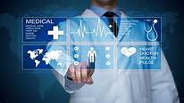
Science and Research:
Computers assist in complex data analysis, modeling, and simulations in scientific research.
DNA sequencing, weather forecasting, and drug discovery depend on high-performance computing.
Data visualization tools help researchers interpret and present their findings effectively.
Engineering and Architecture:
Computer-aided design (CAD) software enables engineers and architects to create and simulate designs.
Structural analysis and simulation software aid in testing and optimizing designs for efficiency and safety.
Computers control and assist in automation and robotics in manufacturing processes.
Transportation and Logistics:
Computers are used for route optimization, traffic management, and real-time tracking of vehicles.
Warehouse management systems rely on computers for inventory control, order processing, and logistics planning.

Slide 10
Reference
https://www.britannica.com/technology/computer
https://youtu.be/z3KnlfATUek
https://www.researchgate.net/publication/367113953_Generation_of_Computers
https://youtu.be/CJ5uKGgxe_U
https://www.bing.com/search?q=article+on+types+of+computers&form=ANNTH1&refig=6d05de045ab74553a17426847c7597d7&sp=1&lq=0&qs=HS&sc=10-0&cvid=6d05de045ab74553a17426847c7597d7#
https://youtu.be/hITuAifbPcQ

Slide 11


